Slide 2
What Rich
Clients Want
NATHAN FOY
Fortis
Audio Visual
Sponsor
Coffee Sponsor

Slide 3
Welcome & Thank You to Our Sponsors
Coffee Sponsor
Audio Visual Sponsor

Slide 4
Text +1 864 660 3590 for Questions
Notes:
title slide with branded photo - option 3 dark

Slide 5
Text +1 864 660 3590 for Questions

Slide 6
Text +1 864 660 3590 for Questions

Slide 7
G O O D N E W S …
There will be much market disruption of white collar people doing knowledge work—lawyers, doctors, accountants. Chauffeurs will still exist and even thrive because no one wants to get in vehicle that can get hacked.
B A D N E W S …
There will be lots of white collar workers who will start to do service jobs like chauffeuring— creating more competition as people see it as field that won't be disrupted.
G O O D N E W S …
There's a way to differentiate that creates more value, and we've proven that. If you apply these principles, you'll be poised to succeed in a space that's here to stay.
If you don't, I think those that do will leave you behind.
Text +1 864 660 3590 for Questions

Slide 8
If…
Text +1 864 660 3590 for Questions

Slide 9
We are helping create a legendary level of service in this industry.
Not about fleets or even technology but about a model of service.
Text +1 864 660 3590 for Questions

Slide 10
W E A R E I M A G E B E A R E R S O F G O D
Text +1 864 660 3590 for Questions

Slide 11
What I
Discovered
Differences in most discerning UHNW clients and others.
Text +1 864 660 3590 for Questions

Slide 12
They won't tell you what they want —you have to decipher what they want.
Text +1 864 660 3590 for Questions

Slide 13
Text +1 864 660 3590 for Questions

Slide 14
“
Working with Fortis has been and inspiration and has changed my life for the better.
“
Text +1 864 660 3590 for Questions

Slide 15
Skyscraper
of Success
Text +1 864 660 3590 for Questions

Slide 16
Skyscraper
of Success
Text +1 864 660 3590 for Questions

Slide 17
Skyscraper
of Success
Text +1 864 660 3590 for Questions

Slide 18
Skyscraper
of Success
Text +1 864 660 3590 for Questions

Slide 19
Skyscraper
of Success
Text +1 864 660 3590 for Questions

Slide 20
Application to You
Text +1 864 660 3590 for Questions

Slide 21
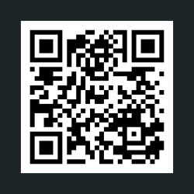
Apply with Fortis
Sometimes it takes 1-3 years for a chance. If that's too long, that's ok!
Text +1 864 660 3590 for Questions

Slide 22
Use these principles to refine your service even if you never work with Fortis—
they work!
Text +1 864 660 3590 for Questions

Slide 23
Soft skills are becoming the hard currency of the future.
And that's more than a business card!
Text +1 864 660 3590 for Questions

Slide 24
Book
Signing
Text +1 864 660 3590 for Questions

Slide 25
Thank you!
Text +1 864 660 3590 for Questions

Slide 26
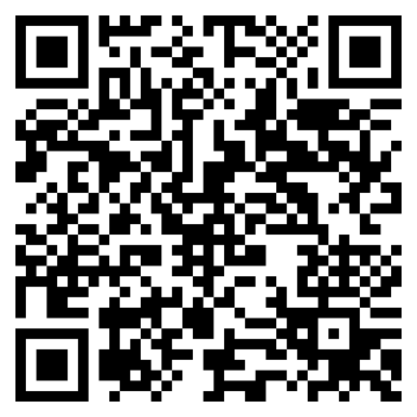
Let Us Know How
We Did!
Fill Out the Survey

Slide 27
Thank You for Joining Us!

